Slide 1
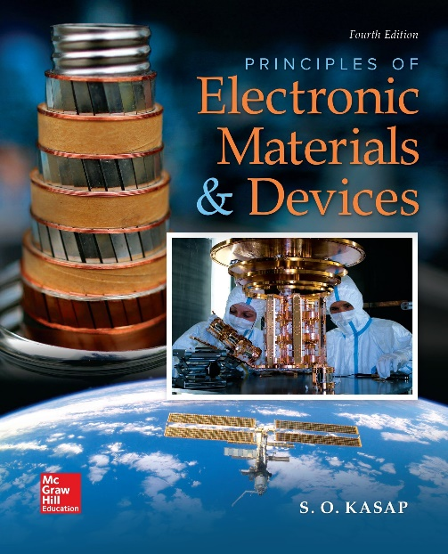
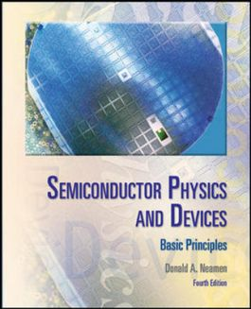

ELECTRONIC MATERIALS AND DEVICES
L | T | P | J | C
3 | 0 | 0 | 0 | 3
Dr. M. Saranya Nair
School of Electronics Engineering
VIT-Chennai Campus
E-mail : saranyanair.m@vit.ac.in
MODULE 6

Slide 2
ELECTRONIC MATERIALS AND DEVICES
MODULE 6
Field Effect Transistor

Slide 3
Field Effect Transistor – MOSFET TWO-TERMINAL MOS STRUCTURE : MOS-CAPacitor (MOSCAP)
The heart of the MOSFET is the MOS-CAPacitor (MOSCAP)
The metal may be aluminium or it is actually a high-conductivity silicon that has been deposited on the oxide; however, the term metal is usually still used. The parameter tox in the figure is the thickness of the oxide and εox is the permittivity of the oxide.
Before Studying about MOSCAP, let’s discuss about Metal-Semiconductor Contact (Module 4)

Slide 4
Metal-Semiconductors Contacts
The metal-semiconductor (MS) contact / junction is that a metal and a semiconductor material are contacted closely. Basically, there are two types of MS contacts that are widely used in semiconductor devices:
Rectifying Schottky Diodes
Non-rectifying Ohmic contact
Here we will discuss the rectifying contact, called the Schottky barrier contact.
For a metal and an n-type semiconductor, a rectifying Schottky contact is formed when Φ_{M}>Φ_{S}, and an Ohmic contact is formed when Φ_{M}<Φ_{S} and vice versa for a metal and an p-type semiconductor.

Slide 5
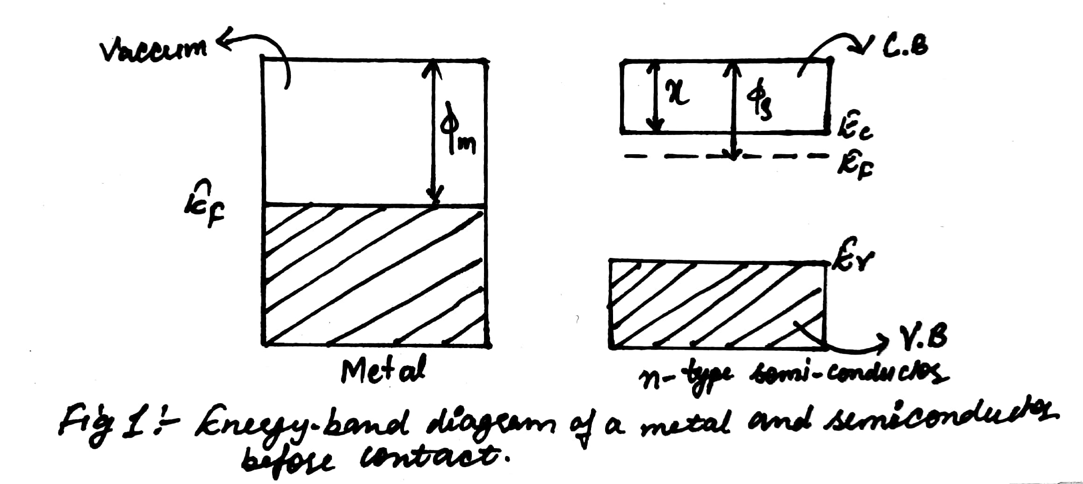
The schematic below shows a metal and an n-type semiconductor. The work functions of the metal and semiconductor have been labelled Φ_{M} and Φ_{S} respectively.
Before discussing the behaviour of a metal-semiconductor boundary, it is first necessary to introduce the concept of the work function. The work function of a material is the energy required to remove an electron from the Fermi level of a solid to a point in the vacuum (top of the conduction band) immediately outside the solid surface. The symbol for work function is Φ.

Slide 6
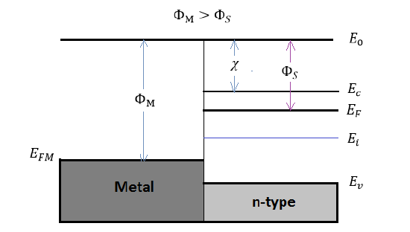
When a metal and a semiconductor material are brought together, an instant ideal MS contact is formed. If there is no electron movement during the contacting process, the band diagram for the contact will be as in Figure, where there is a mismatch for the Fermi level in the metal and the Fermi level in the semiconductor.
However, the situations in Figure are not in equilibrium condition, since the Fermi energy in the metal is not aligned with the Fermi energy in semiconductor. Therefore, electrons will keep transferring between the semiconductor and the metal until the E_{F} is aligned, which would cause a formation of depletion region between the MS contact.

Slide 7
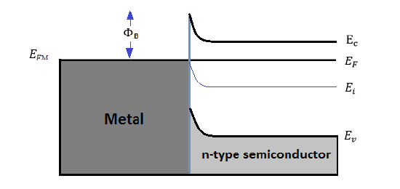
The Schottky barrier contact refers to the MS contact having a large potential barrier height formed when the Fermi energy of the metal and the semiconductor are aligned together.
The barrier height is defined as the energy difference between the band edge with majority carriers and the Fermi energy of the metal.
Since the Schottky barriers could lead to rectifying characteristics, it is normally used as a diode, which is a single MS junction with rectifying characteristics.
Both n-type and p-type semiconductors can form the Schottky contact

Slide 8
Under Equilibrium Condition (applied bias V=0)
Consider the case of Φ_{M}>Φ_{S}, electrons will transfer from the semiconductor to the metal until the equilibrium condition is established. The net loss of electrons creates a negative charge in the metal and a positive charge in the semiconductor, which results a depletion region and a growing barrier at the semiconductor surface. As the result, the equilibrium band structure for a metal and a n-type semiconductor is illustrated in Figure.

Slide 9
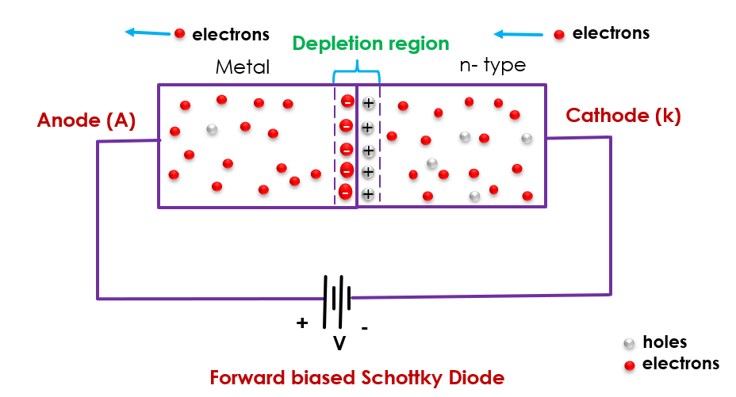
Forward Biasing
Under a forward biasing, the operation of MS junction is illustrated in Figure. There results a reduction of the potential barrier across the semiconductor. Consequently, it will be much easier for electrons to pass over the barrier, which makes the electrons diffuse much easier from semiconductor to the metal. Therefore, as the V_{A} increasing, the current will increase rapidly, since more electrons will be able to overcome the surface barrier. There will be more electrons diffuse from the semiconductor towards the metal, a positive current will be generated across the MS junction.

Slide 10
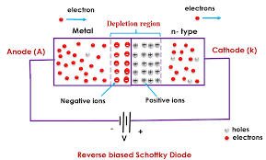
Reverse Biasing
With an negative applied bias on the metal, the operation of MS junction is illustrated in Figure. There results an increasing of the barrier potential across the MS junction. The large barrier will block the diffusion of electrons from semiconductor to the metal. Therefore, the current will become a small constant at reversed bias, which is characterized as the rectifying behavior.
Figure 6. Schematic IVIV characteristics of Schottky diodes

Slide 11
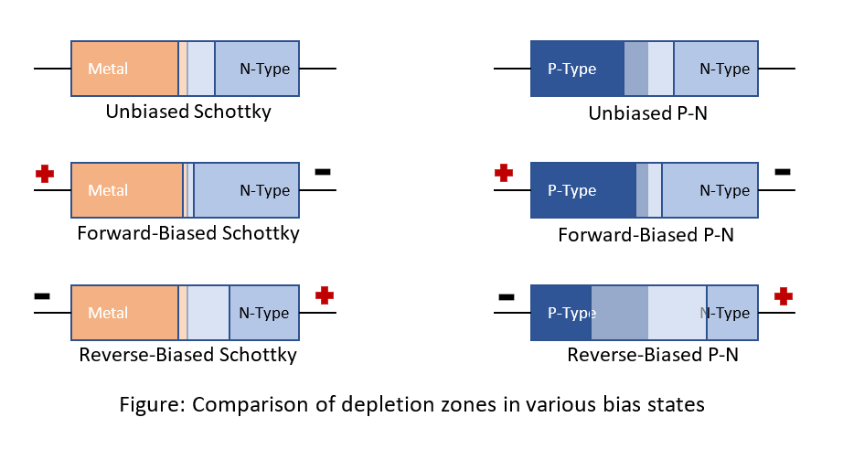
Summary

Slide 12
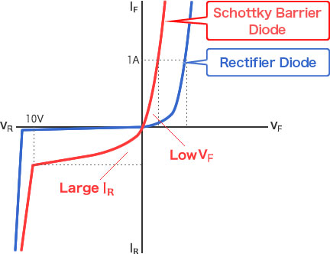
PN vs Schottky

Slide 13
Metal Oxide Semiconductor MOS Capacitor

Slide 14
The physics of the MOS structure can be more easily explained with the aid of the simple parallel-plate capacitor.
MOS capacitor with a p-type semiconductor substrate. The top metal gate is at a negative voltage with respect to the semiconductor substrate – Forward Bias.
We can see that a negative charge will exist on the top metal plate and an electric field will be induced with the direction shown in the figure.
The majority carrier holes would experience a force toward the oxide– semiconductor interface.
An accumulation layer of holes at the oxide–semiconductor junction corresponds to the positive charge on the bottom “plate” of the MOS capacitor.

Slide 15
Reverse Bias - Majority carrier holes will experience a force away from the oxide–semiconductor interface. As the holes are pushed away from the interface, a negative space charge region is created. The negative charge in the induced depletion region corresponds to the negative charge on the bottom “plate” of the MOS capacitor.

Slide 16
MOSCAP – Energy Band Diagrams
The energy bands in the semiconductor are flat indicating no net charge exists in the semiconductor. This condition is known as flat band.

Slide 17
The Fermi level is a constant in the semiconductor since the MOS system is in thermal equilibrium and there is no current through the oxide.
The valence-band edge is closer to the Fermi level at the oxide–semiconductor interface than in the bulk material, which implies that there is an accumulation of holes.
The semiconductor surface appears to be more p-type than the bulk material.

Slide 18
The conduction- and valence- band edges bend as shown in the figure. The conduction band and intrinsic Fermi levels move closer to the Fermi level.
Now consider the case when a still larger positive voltage is applied to the top metal gate of the MOS capacitor. We expect the induced electric field to increase in magnitude and the corresponding positive and negative charges on the MOS capacitor to increase. A larger negative charge in the MOS capacitor implies a larger induced space charge region and more band bending.
By applying a sufficiently large positive gate voltage, we have inverted the surface of the semiconductor from a p-type to an n-type semiconductor. We have created an inversion layer of electrons at the oxide–semiconductor interface.

Slide 19
MOSCAP - Depletion Layer Thickness

Slide 20
The electron concentration at the surface is the same as the hole concentration in the bulk material. This condition is known as the threshold inversion point. The applied gate voltage creating this condition is known as the threshold voltage.

Slide 21
Calculate the maximum space charge width for a given semiconductor doping concentration.
Consider silicon at T = 300 K doped to Na = 10¹⁶ /cm³. The intrinsic carrier concentration
is 1.5 x 10¹⁰ /cm³.

Slide 22
THE BASIC MOSFET OPERATION
The current in a MOSFET is due to the flow of charge in the inversion layer or channel region adjacent to the oxide–semiconductor interface.
n-channel enhancement mode MOSFET
n-channel depletion mode MOSFET

Slide 23
There are four basic MOSFET device types.
In the enhancement mode, the semiconductor substrate is not inverted directly under the oxide with zero gate voltage.
A positive gate voltage induces the electron inversion layer, which then “connects” the n-type source and the n-type drain regions.
The source terminal is the source of carriers that flow through the channel to the drain terminal.
For this n-channel device, electrons flow from the source to the drain so the conventional current will enter the drain and leave the source.
In the depletion mode, an n-channel region exists under the oxide with 0 V applied to the gate.

Slide 24
Current–Voltage (I-V) Characteristics
n-channel enhancement mode MOSFET with a gate-to-source voltage that is less than the threshold voltage and with only a very small drain-to-source voltage

Slide 25
The source and substrate, or body, terminals are held at ground potential. With this bias configuration, there is no electron inversion layer, the drain-to-substrate junction is reverse biased, and the drain current is zero.
When an applied gate voltage is V_{GS} > V_{T}. An electron inversion layer has been created so that when a small drain voltage is applied, the electrons in the inversion layer will flow from the source to the positive drain terminal. The conventional current enters the drain terminal and leaves the source terminal.
For small VDS values, the channel region has the characteristics of a resistor, so we can write
where gd is defined as the channel conductance

Slide 26
where n is the mobility of the electrons in the inversion layer and
Qn’ is the magnitude of the inversion layer charge per unit area.
When VGS < VT, the drain current is zero. As VGS becomes larger than VT, channel inversion charge density increases, which increases the channel conductance.

Slide 29
Thank you

